Slide 1

DEPARTMENT OF ARTIFICIAL INTELLIGENCE AND DATA SCIENCE
Artificial Neural Networks and Deep Learning: 21ADG64
LA1 - Seminar
“Traffic Sign Recognition”
Presented By
Vaibhav Baid
1NT21AD057
Name of the Course Instructor Dr Meenakshi

Slide 2

CONTENTS
Introduction and Motivation
Methodology and Approach
Results and Analysis
Conclusion and Future Recommendations
Demo video of code
Github link of PPT and Code
References

Slide 3
INTRODUCTION
Traffic sign recognition is a critical component of autonomous driving systems and advanced driver assistance systems (ADAS). With the increasing adoption of these technologies, accurate and efficient traffic sign recognition becomes essential for ensuring safety on the roads. This project aims to develop a robust traffic sign recognition system using machine learning techniques to improve road safety and enhance driving experiences.

Slide 4
METHODOLOGY AND APPROACH
The methodology involves several steps, including data collection, preprocessing, feature extraction, model training, and evaluation. We utilize convolutional neural networks (CNNs), a type of deep learning algorithm, for their ability to automatically learn features from raw image data. The approach includes training the CNN model on a labeled dataset of traffic sign images to classify them into predefined categories corresponding to different traffic signs.

Slide 5
RESULT AND ANALYSIS
The results demonstrate the effectiveness of the proposed traffic sign recognition system. Evaluation metrics such as accuracy, precision, recall, and F1-score are used to assess the performance of the model. The analysis includes a comparison of different models and techniques, highlighting the strengths and weaknesses of each approach. Visualizations such as confusion matrices and precision-recall curves provide insights into the model's behavior and performance.

Slide 6
CONCLUSION
In conclusion, the project successfully develops a traffic sign recognition system with promising performance. However, there is room for improvement in terms of accuracy and computational efficiency. Future recommendations include exploring advanced techniques such as transfer learning, data augmentation, and ensemble methods to enhance the model's performance further. Additionally, integrating the system into real-world applications and conducting extensive field testing are crucial steps for practical deployment.

Slide 7
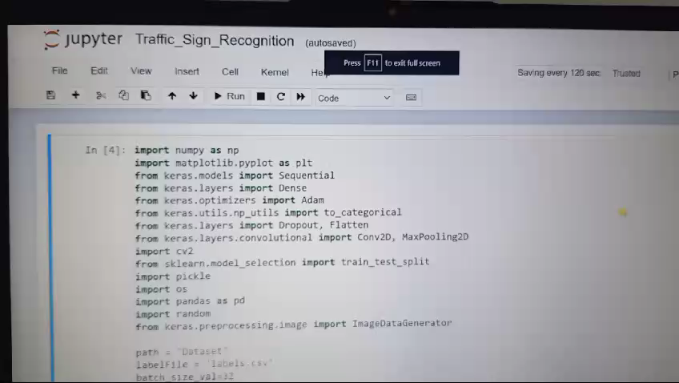
DEMO VIDEO OF CODE

Slide 8
GITHUB LINK

Slide 9
REFERENCES
[1]Sermanet, Pierre, et al. "Traffic sign recognition with multi-scale convolutional networks." Proceedings of the International Joint Conference on Neural Networks (IJCNN). IEEE, 2011.
[2] Houben, S., Stallkamp, J., Salmen, J., & Schlipsing, M. (2013). "Detection of traffic signs in real-world images: The German Traffic Sign Detection Benchmark." Proceedings of the IEEE International Joint Conference on Neural Networks (IJCNN), 2013.
[3] Simonyan, Karen, and Andrew Zisserman. "Very deep convolutional networks for large-scale image recognition." arXiv preprint arXiv:1409.1556 (2014).

